Slide 1
An Introduction to Deep Neural Network
Irene Kim

Slide 2

Artificial Intelligence
Make machine learn to see, hear, speak, and predict.
Machine learning
Perform a specific task without using explicit instructions
Deep Neural Network

Slide 3
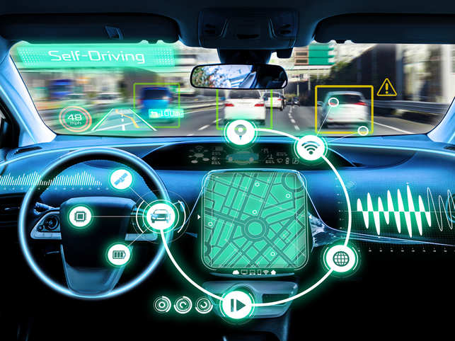
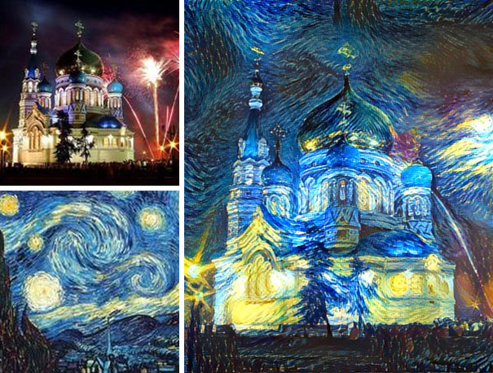
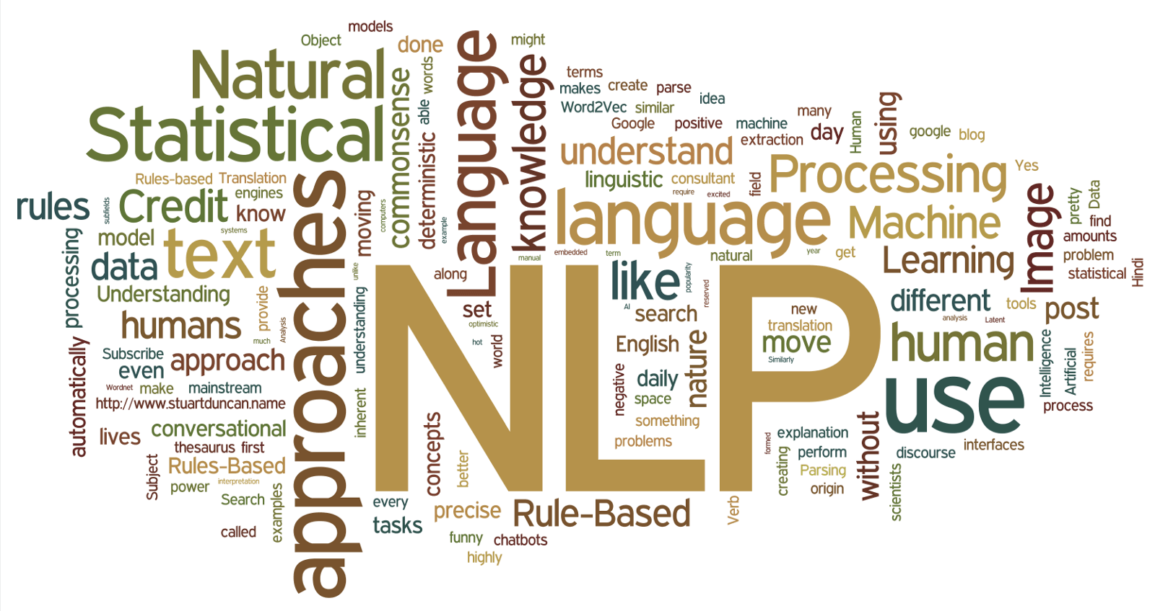

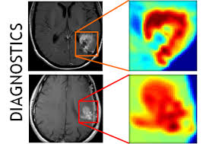

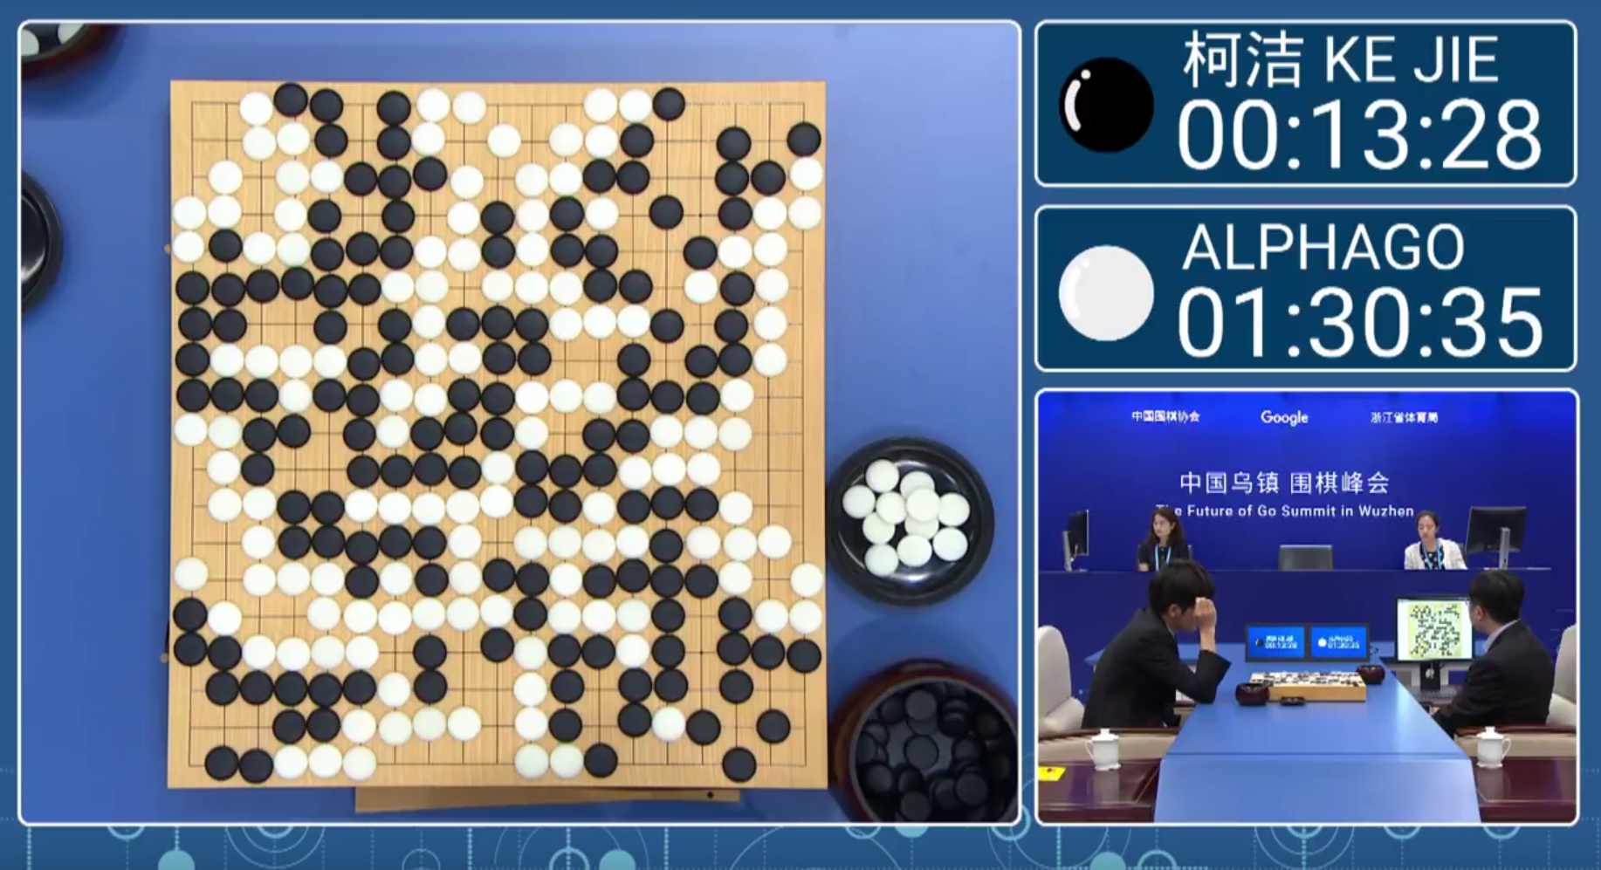

The Rise of Deep Neural Network
Notes:
Smart compose

Slide 4
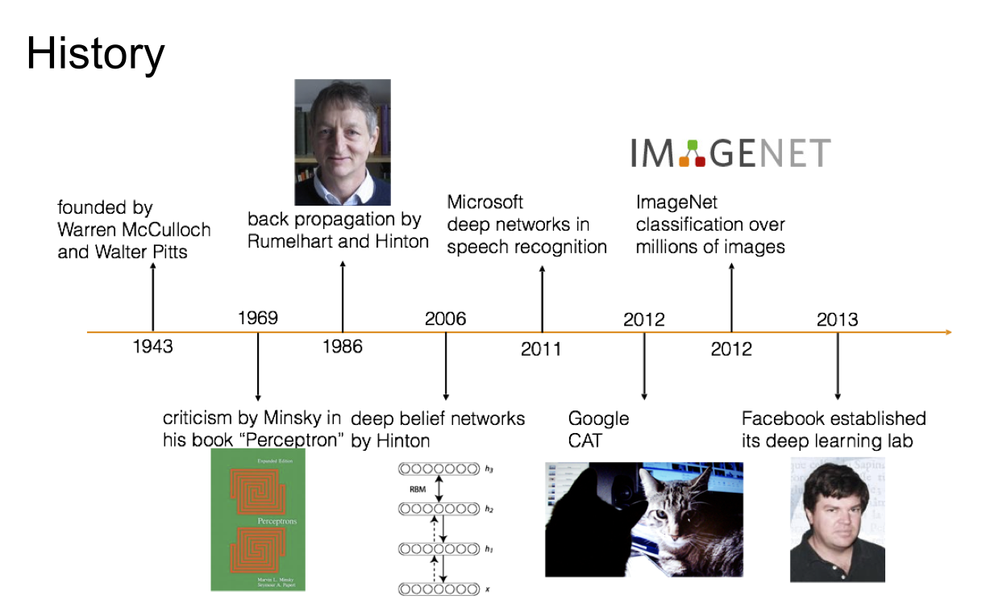
History
Notes:
Big data : large amount of data became available, hardwares : GPU computing. Parallelizable machines, softwares : toolboxes.
Topleft : hinton
Right bottom : yann lecun

Slide 5
Where is Deep Neural Network used?
Why use Deep Neural Network?
Performs well on many data sets
Works well with Big data
Provides new approaches to existing problems
New problems
As a model of data : Y = f(X)
function approximator

Slide 6
So, what is Deep Neural Network?
How does it work?
What is the basic building block?

Slide 7
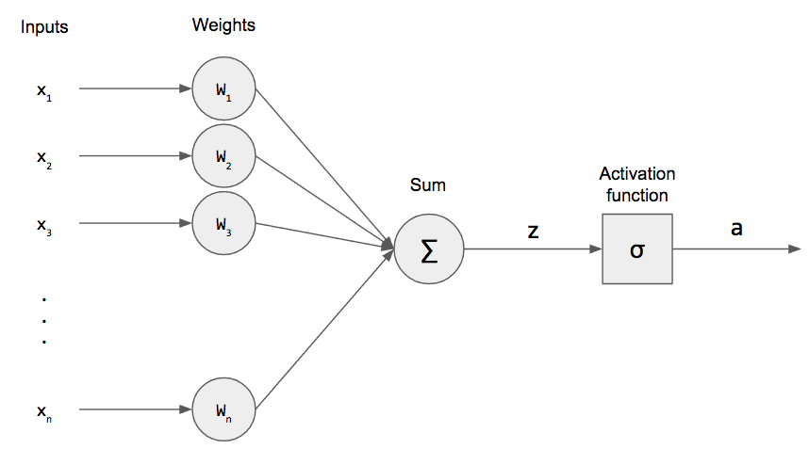
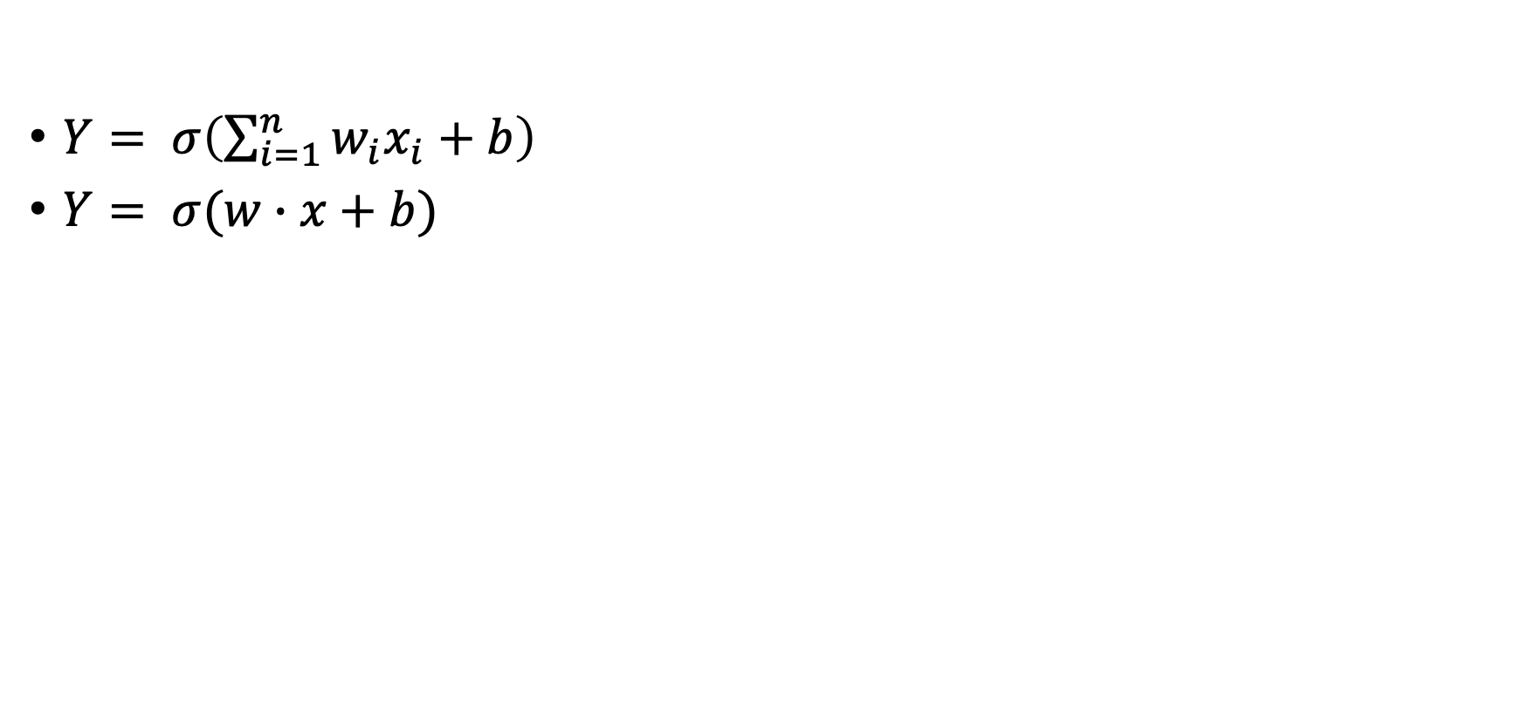
Perceptron : A single Neuron in a Neural Net
$Y= σ\left(\sum_{i=1}^{n}{w_{i}x_{i}+b}\right)$
$Y= σ(w∙x+b)$
Non linear :
Activation function
Linear :
Weights, Biases
y
Notes:
notate as a sum

Slide 8
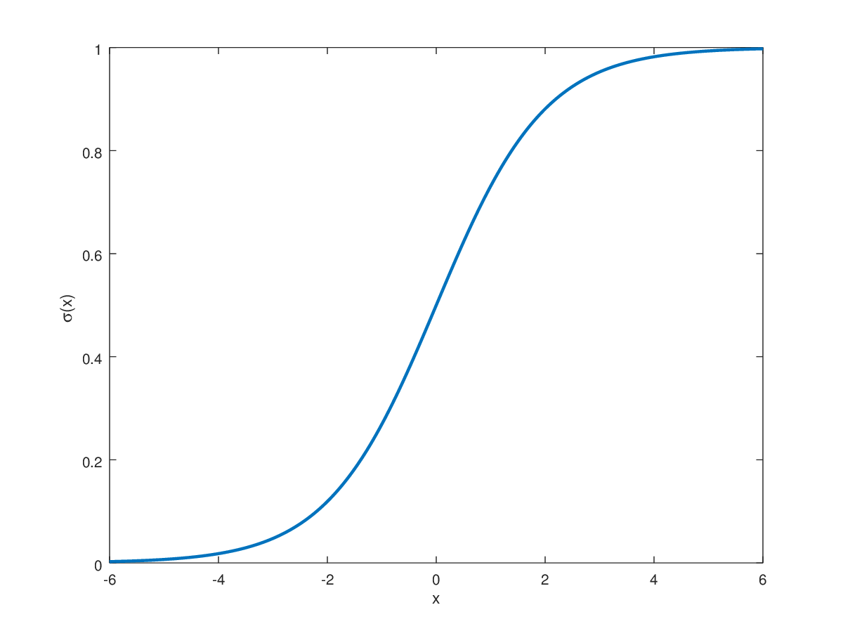
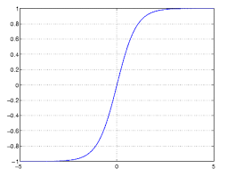
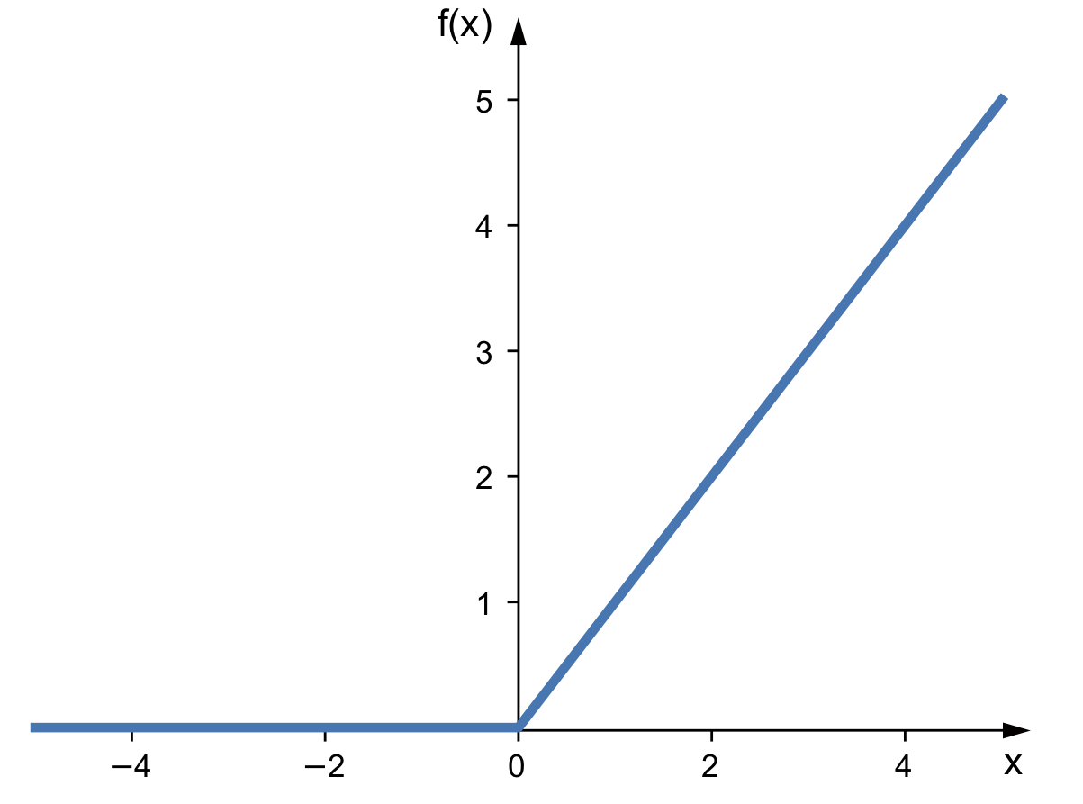
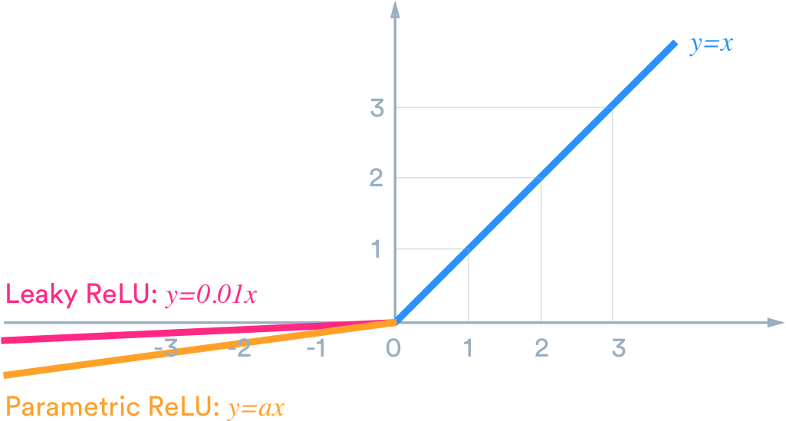
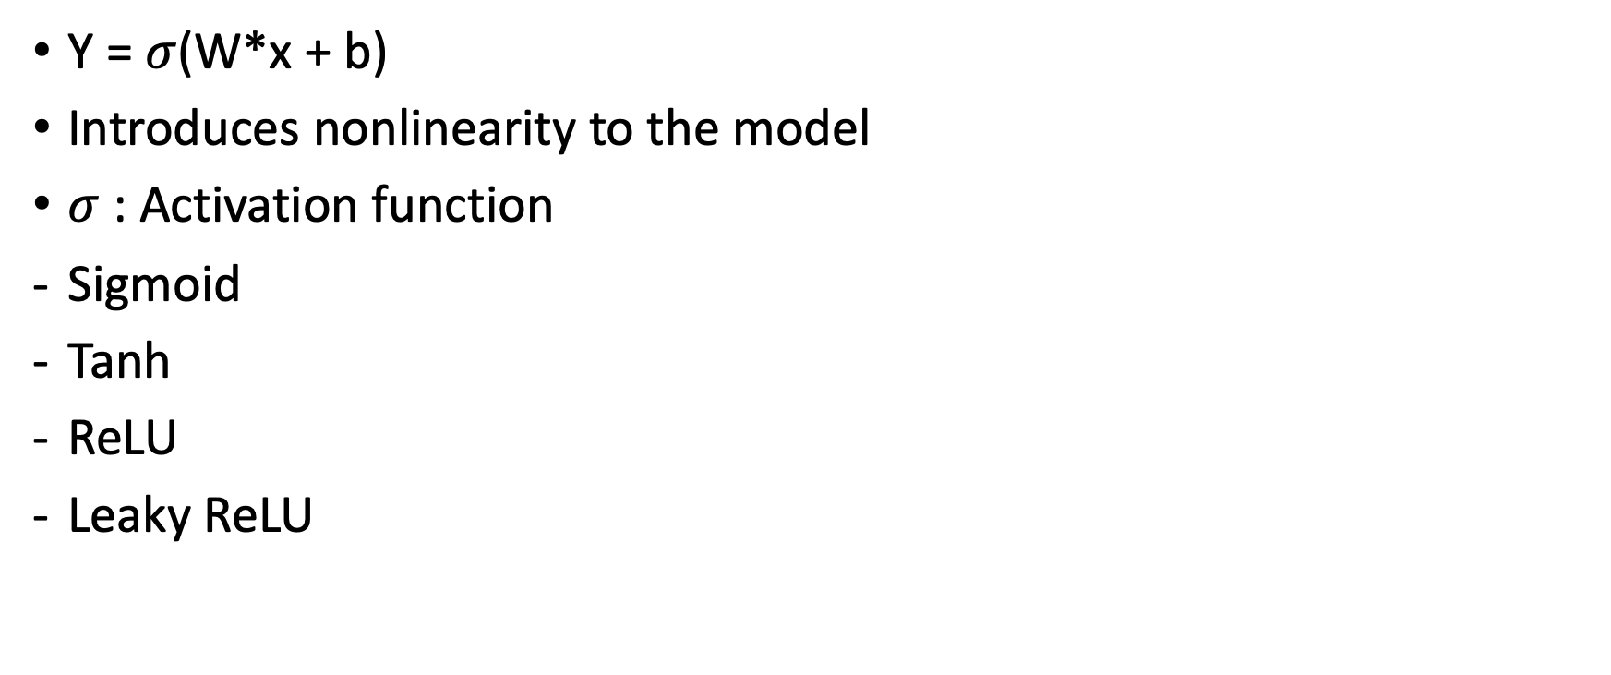
Activation functions
Y = $σ$(W*x + b)
Introduces nonlinearity to the model
$σ$ : Activation function
Sigmoid
Tanh
ReLU
Leaky ReLU
Sigmoid
Tanh
ReLU
Leaky ReLU
Notes:
There are differences in the activation function output range.
Choice is arbitrary but there are popular ones

Slide 9

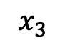
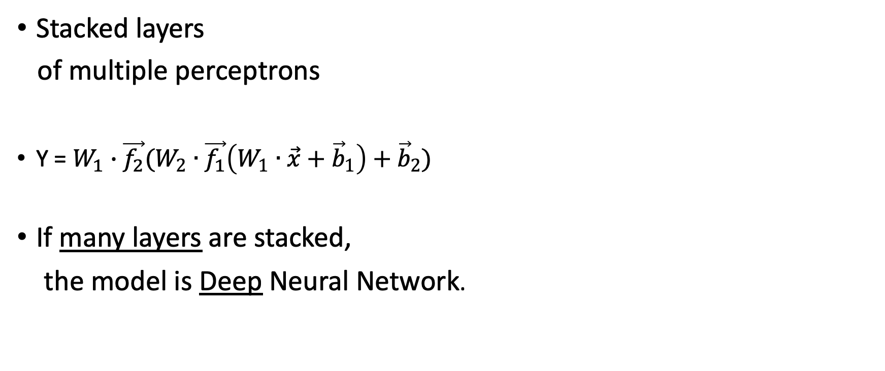
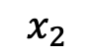

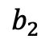
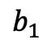
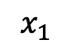
Deep Neural Net Model :
One perceptron
$$b_{1}$$
$$b_{2}$$
Stacked layers
of multiple perceptrons
Y = $W_{1}∙\vec{f_{2}}(W_{2}∙\vec{f_{1}}\left(W_{1}∙\vec{x}+{\vec{b}}_{1}\right)+{\vec{b}}_{2})$
If many layers are stacked,
the model is Deep Neural Network.
$$x_{1}$$
$$x_{2}$$
Y
$$x_{3}$$
Notes:
f1 as a vector notation
the more layers The network gets deeper.
model complexity and going deep

Slide 10

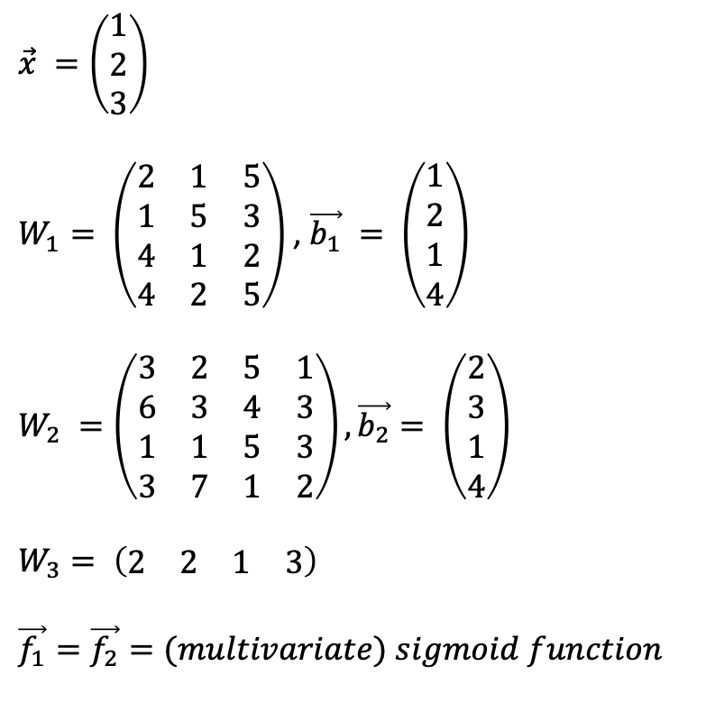


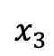

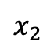

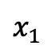

Example
$$\vec{x} =\left(\begin{matrix}1 \\ 2 \\ 3\end{matrix}\right)$$
$W_{1}= \left(\begin{matrix}2 & 1 & 5 \\ 1 & 5 & 3 \\ 4 & 1 & 2 \\ 4 & 2 & 5\end{matrix}\right)$ , $\vec{b_{1}} = \left(\begin{matrix}1 \\ 2 \\ 1 \\ 4\end{matrix}\right)$
$$W_{2} =\left(\begin{matrix}3 & 2 & 5 & 1 \\ 6 & 3 & 4 & 3 \\ 1 & 1 & 5 & 3 \\ 3 & 7 & 1 & 2\end{matrix}\right), \vec{b_{2}}= \left(\begin{matrix}2 \\ 3 \\ 1 \\ 4\end{matrix}\right)$$
$$W_{3}= \left(\begin{matrix}2 & 2 & 1 & 3\end{matrix}\right)$$
$$\vec{f_{1}}=\vec{f_{2}}=(multivariate) sigmoid function$$
$$w_{11}$$
$$w_{11}$$
$$w_{12}$$
$$w_{13}$$
$$x_{1}$$
$$w_{12}$$
$$x_{2}$$
Y
$$w_{13}$$
$$x_{3}$$

Slide 11
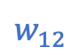

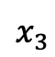
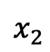
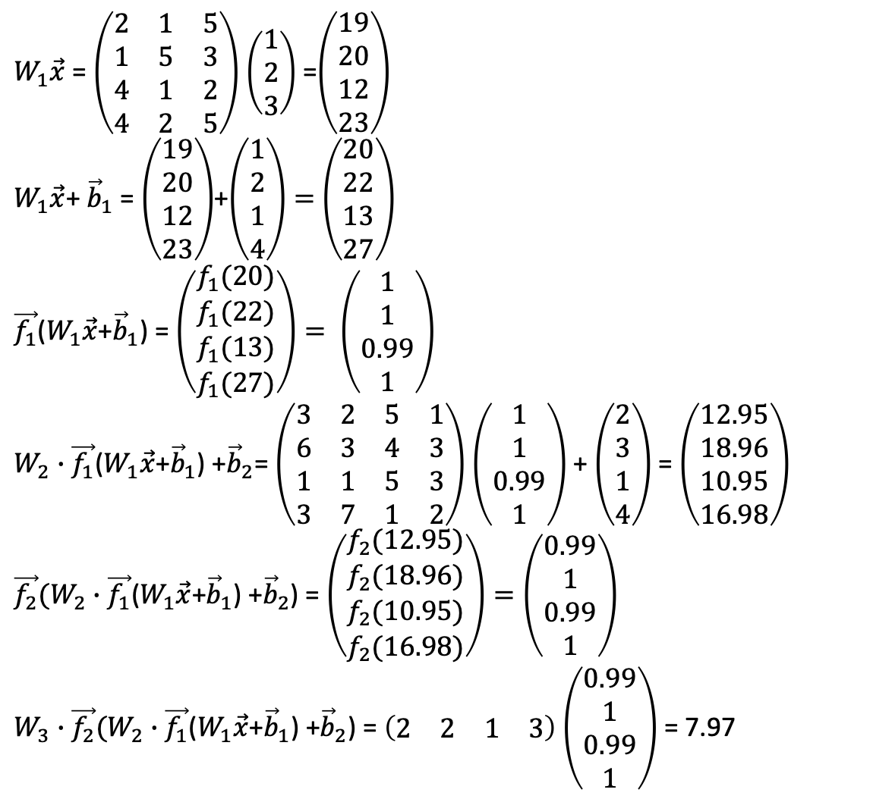
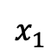

Example
$W_{1}\vec{x}$ = $\left(\begin{matrix}2 & 1 & 5 \\ 1 & 5 & 3 \\ 4 & 1 & 2 \\ 4 & 2 & 5\end{matrix}\right)$ $\left(\begin{matrix}1 \\ 2 \\ 3\end{matrix}\right)$ =$\left(\begin{matrix}19 \\ 20 \\ 12 \\ 23\end{matrix}\right)$
$W_{1}\vec{x}$+ ${\vec{b}}_{1}$ = $\left(\begin{matrix}19 \\ 20 \\ 12 \\ 23\end{matrix}\right)$+$\left(\begin{matrix}1 \\ 2 \\ 1 \\ 4\end{matrix}\right)=$ $\left(\begin{matrix}20 \\ 22 \\ 13 \\ 27\end{matrix}\right)$
$\vec{f_{1}}$($W_{1}\vec{x}$+${\vec{b}}_{1}$) = $\left(\begin{matrix}f_{1}(20) \\ f_{1}(22) \\ f_{1}(13) \\ f_{1}(27)\end{matrix}\right)= \left(\begin{matrix}1 \\ 1 \\ 0.99 \\ 1\end{matrix}\right)$
$W_{2}∙\vec{f_{1}}$($W_{1}\vec{x}$+${\vec{b}}_{1}$) +${\vec{b}}_{2}$= $\left(\begin{matrix}3 & 2 & 5 & 1 \\ 6 & 3 & 4 & 3 \\ 1 & 1 & 5 & 3 \\ 3 & 7 & 1 & 2\end{matrix}\right)$ $\left(\begin{matrix}1 \\ 1 \\ 0.99 \\ 1\end{matrix}\right)$ + $\left(\begin{matrix}2 \\ 3 \\ 1 \\ 4\end{matrix}\right)$ = $\left(\begin{matrix}12.95 \\ 18.96 \\ 10.95 \\ 16.98\end{matrix}\right)$
$\vec{f_{2}}(W_{2}∙\vec{f_{1}}$($W_{1}\vec{x}$+${\vec{b}}_{1}$) +${\vec{b}}_{2}$) = $\left(\begin{matrix}f_{2}(12.95) \\ f_{2}(18.96) \\ f_{2}(10.95) \\ f_{2}(16.98)\end{matrix}\right)=\left(\begin{matrix}0.99 \\ 1 \\ 0.99 \\ 1\end{matrix}\right)$
$W_{3}∙\vec{f_{2}}(W_{2}∙\vec{f_{1}}$($W_{1}\vec{x}$+${\vec{b}}_{1}$) +${\vec{b}}_{2}$) = $\left(\begin{matrix}2 & 2 & 1 & 3\end{matrix}\right)$ $\left(\begin{matrix}0.99 \\ 1 \\ 0.99 \\ 1\end{matrix}\right)$ = 7.97
$$w_{11}$$
$$x_{1}$$
$$w_{12}$$
$$x_{2}$$
Y
$$w_{13}$$
$$x_{3}$$
Notes:
we can go deeper with the conposition

Slide 12
Properties..
Universal approximation theorem : One layer model can approximate (almost) any function as good as we want using only one hidden layer!
There are benefits in using Deep networks compared to shallow networks.
Notes:
cite : When and Why Are Deep Networks Better than Shallow Ones?
before mentioning, mention that the problems can be viewed as a function approximation problem.

Slide 13
2 steps
Set up Model Architecture
Train(fit) weight matrices and biases

Slide 14



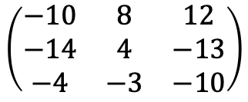
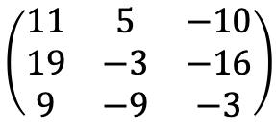
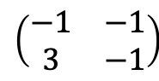
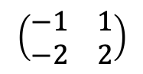
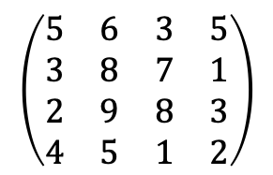
Popular model architectures
2 by 2 Convolutional layer
Feed forward/backward
Recurrent(LSTM)
Convolutional
Variational autoencoder
Generative Adversarial Network
And many others
Not always obvious how to apply an architecture to a new problem you face (solution = research)
$$\left(\begin{matrix}11 & 5 & −10 \\ 19 & −3 & −16 \\ 9 & −9 & −3\end{matrix}\right)$$
$$\left(\begin{matrix}−1 & 1 \\ −2 & 2\end{matrix}\right)$$
$$\left(\begin{matrix}5 & 6 & 3 & 5 \\ 3 & 8 & 7 & 1 \\ 2 & 9 & 8 & 3 \\ 4 & 5 & 1 & 2\end{matrix}\right)$$
$$\left(\begin{matrix}−1 & −1 \\ 3 & −1\end{matrix}\right)$$
$$\left(\begin{matrix}−10 & 8 & 12 \\ −14 & 4 & −13 \\ −4 & −3 & −10\end{matrix}\right)$$
Notes:
convolutional architecture picture

Slide 15
Training
First split the data into a training set and a test set.
Update weights towards minimizing the loss on the training data and see how it works with the test data.(Algorithm : Back propagation, gradient descent, chain rule)
Examples of losses : MSE, cross entropy, Wasserstein distance, KL divergence …
Toolboxes : Tensorflow, pytorch, keras …
Model regularization methods : dropout, loss with penalty…

Slide 16
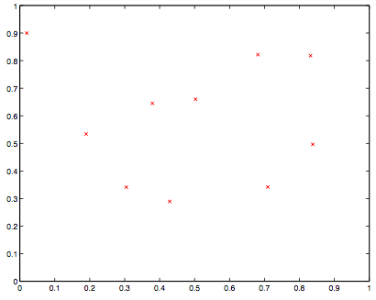
What is overfitting?
samples

Slide 17
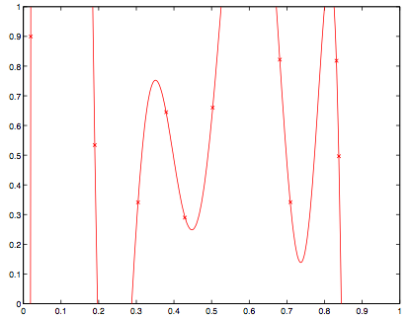
Fit a higher order polynomial interpolant

Slide 18
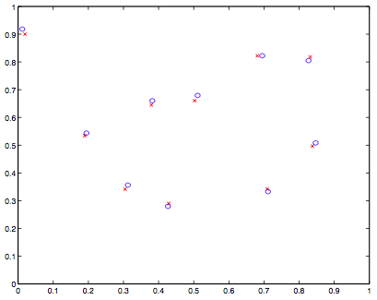
Perturb the points slightly.

Slide 19
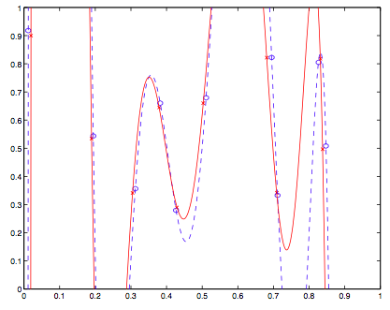
Solution changes a lot!

Slide 20
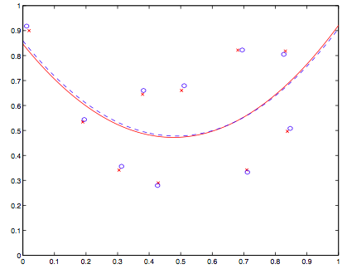
Fit a second order polynomial. Not so bad!

Slide 21
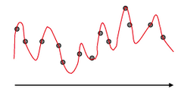
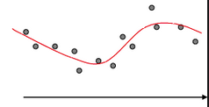
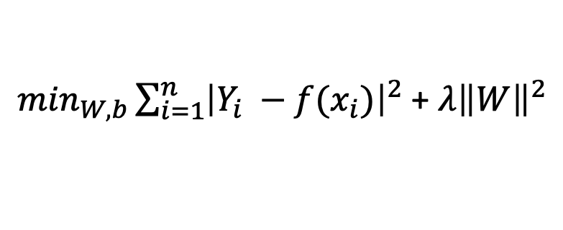
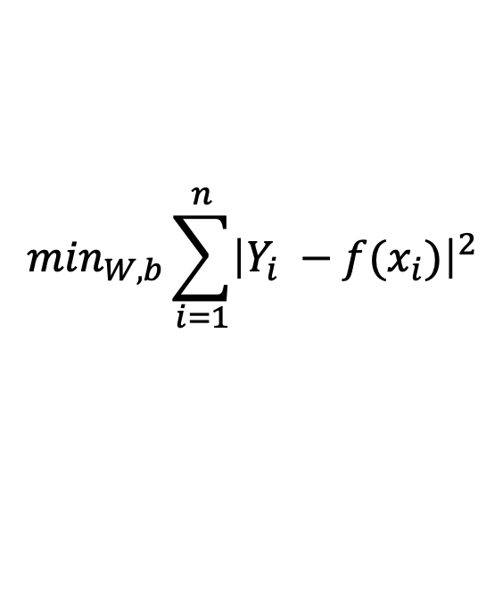
Regularization
$$\min_{W,b}{\sum_{i=1}^{n}{{\left|Y_{i} −f(x_{i})\right|}^{2}}}$$
$\min_{W,b}{\sum_{i=1}^{n}{{\left|Y_{i} −f(x_{i})\right|}^{2}}}$ + $λ{\left\|W\right\|}^{2}$
Techniques to prevent overfitting.
Notes:
fix the notations

Slide 22
What is generalization?
Model's ability to adapt properly to new, previously unseen data.
Overfitted/underfitted models do not generalize well.
Ultimate goal of the model : making good predictions/decisions for new data, i.e., generalize well.

Slide 23
Models that are overfitting/underfitting does not generalize well to new data, and regularization can help!

Slide 24
Common Regularization methods
Penalty in loss such as L1, L2, entropy…
Dropout : randomly mask nodes while training with some probability
Early stopping : stop before the model start to overfit
Data augmentation : Get more (fake) data
Notes:
(https://www.analyticsvidhya.com/blog/2018/04/fundamentals-deep-learning-regularization-techniques/)
https://towardsdatascience.com/how-to-improve-a-neural-network-with-regularization-8a18ecda9fe3
Constrain the
stop training before the model start to overfit

Slide 25
Decisions to make
Model Architecture
Number of nodes and layers
How layers are connected
Choice of activation functions
Choice of loss
Model Regularization
What method to use
If drop out, drop out rate
Training algorithm related
Learning rate, momentum
Initial weights
Epochs, batch size
Other methods to consider
Standardize the scale of data before training
Whether to do batch normalization
Notes:
https://towardsdatascience.com/what-are-hyperparameters-and-how-to-tune-the-hyperparameters-in-a-deep-neural-network-d0604917584a
hyperparameter word define first before using
group the more crucial parameters and less crucial parameters
details of model architecture/ model regularization/

Slide 26
We can make decisions and fit a great model, but …
It is difficult to know what is actually happening..
(interpret = research!)

Slide 27
Lets fit example models
Example 1 : https://playground.tensorflow.org
Example2 : python tensorflow

Slide 28
Useful sites
https://playground.tensorflow.org
MIT short course : http://introtodeeplearning.com
Stanford course on Deep learning : https://cs230.stanford.edu/
Stanford course on convolutional NN : http://cs231n.github.io/
Michael Nielsen’s Book : http://neuralnetworksanddeeplearning.com/

